Slide 1

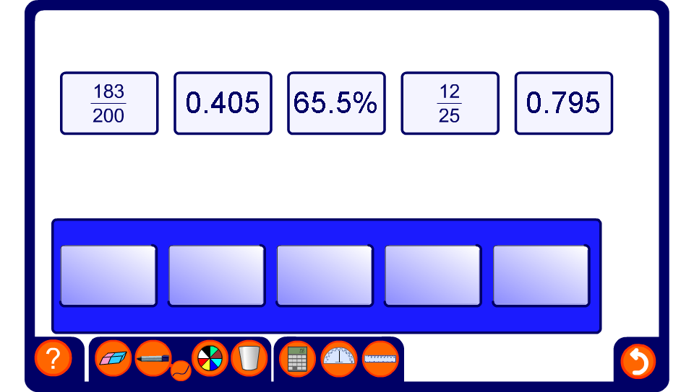


Ordering on a number line
Notes:
Ask pupils to pick out the smallest fraction, decimal or percentage and place it on the number line. Continue until each one is in place. Discuss how we could express all of these as percentages to order them more easily. Remind pupils that 1 = 100% and 2 = 200%.

